Slide 1

XY
XY
XY
XY
XY
XY
XY
XY
XY
XY
XY
XY
XY
XY
XY
XY
XY
XY
XY
XY
XY
XY
XY
XY
XY
XY
XY
XY
XY
XY
XY
XY
XY
XY
XY
XY
XY
XY
XY
XY
XY
XY
ρ

Slide 2
Sample_{C}
Sample_{D}
r_{XY}
r_{XY}
Population
Sample_{B}
ρ_{XY}
r_{XY}
Sample_{E}
Sample_{A}
_
r_{XY}
r_{XY}

Slide 3
The t distribution, at N-2 degrees of freedom, can be used to test the probability that the statistic r was drawn from a population with ρ = 0. Table C.
H₀ : ρ _{XY} = 0
H₁ : ρ _{XY} ≠ 0
where
r N - 2
t =
1 - r²

Slide 4
Monday, November 5
Independent samples t-test
for the difference between two means.

Slide 5
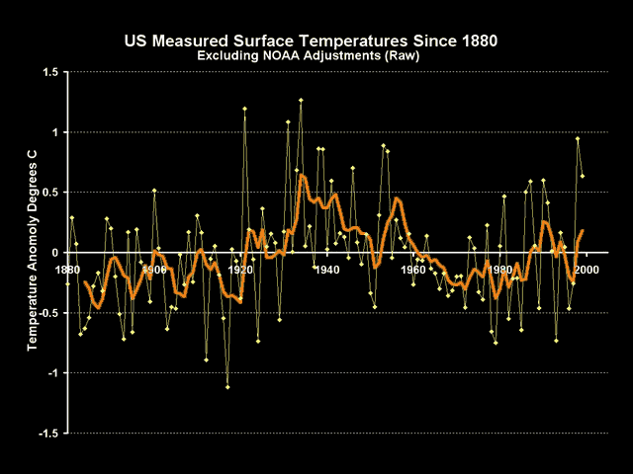
Monday, November 7
Independent samples t-test
for the difference between two means.
signal-to-noise ratio

Slide 6

Monday, November 7
Independent samples t-test
for the difference between two means.
signal-to-noise ratio
safety in numbers

Slide 7
_
_
X₁- X₂
_
_
_
_
X₁- X₂
_
_
_
_
X₁- X₂
_
_
X₁- X₂
X₁- X₂
X₁- X₂
_
_
_
_
X₁- X₂
_
_
_
_
_
_
X₁- X₂
X₁- X₂
_
_
X₁- X₂
X₁- X₂
X₁- X₂
X₁-X₂
μ1- μ2

Slide 8
H₀ : μ₁ - μ₂ = 0
H₁ : μ₁ - μ₂ ≠ 0

Slide 10
_
_
X_{boys}=53.75
X_{girls}=51.16
How do we know if the difference between these means,
of 53.75 - 51.16 = 2.59, is reliably different from zero?

Slide 11
We could find confidence intervals around each mean...
_
X_{boys}=53.75
95CI: 52.07 < μ _{boys} < 55.43
_
X_{girls}=51.16
95CI: 49.64 < μ _{girls} < 52.68

Slide 12
H₀ : μ₁ - μ₂ = 0
H₁ : μ₁ - μ₂ ≠ 0
But we can directly test this hypothesis...

Slide 13
H₀ : μ₁ - μ₂ = 0
H₁ : μ₁ - μ₂ ≠ 0
To test this hypothesis, you need to know …
…the sampling distribution of the difference between means.
-
-
σ_{X1-X2}

Slide 14
H₀ : μ₁ - μ₂ = 0
H₁ : μ₁ - μ₂ ≠ 0
To test this hypothesis, you need to know …
…the sampling distribution of the difference between means.
-
-
σ_{X1-X2}
…which can be used as the error term
in the test statistic.

Slide 15
The sampling distribution of the difference between means.
σ_{X1-X2} = √ σ²_{X1} + σ²_{X2}
-
-
-
-
This reflects the fact that two independent variances
contribute to the variance in the difference between
the means.

Slide 16
The sampling distribution of the difference between means.
σ_{X1-X2} = √ σ²_{X1} + σ²_{X2}
-
-
-
-
This reflects the fact that two independent variances
contribute to the variance in the difference between
the means.
Your intuition should tell you that the variance in the
differences between two means is larger than the variance
in either of the means separately.

Slide 17
The sampling distribution of the difference between means,
at n = ∞, would be:
-
-
(X₁ - X₂)
z =
σ_{X1-X2}
-
-

Slide 18
The sampling distribution of the difference between means.
-
-
σ_{X1-X2} = σ²₁ σ²₂
+
n₁ n₂
Since we don’t know σ, we must estimate it with the sample statistic s.

Slide 19
The sampling distribution of the difference between means.
-
-
σ_{X1-X2} = s²₁ s²₂
+
n₁ n₂

Slide 20
The sampling distribution of the difference between means.
-
-
σ_{X1-X2} = s²₁ s²₂
+
n₁ n₂
Rather than using s²₁ to estimate σ²₁ and s²₂ to estimate σ²₂ , we pool the two
variance estimates to create a more stable estimate of σ²₁ and σ²₂ by assuming
that the variances in the two samples are equal, that is, σ²₁ = σ²₂ .

Slide 21
_
_
X_{boys}=53.75
X_{girls}=51.16
How do we know if the difference between these means,
of 53.75 - 51.16 = 2.59, is reliably different from zero?

Slide 22
s_{p}² s_{p}²
s_{X1-X2} =
+
N₁ N₂

Slide 23
s_{p}² s_{p}²
s_{X1-X2} =
+
N₁ N₂
SS_{w} SS₁ + SS₂
s_{p}² =
=
N-2 N-2

Slide 24
Because we are making estimates that vary by degrees of freedom,
we use the t-distribution to test the hypothesis.
(X₁ - X₂) - (μ₁ - μ₂ )
t =
s_{X1-X2}
…at (n₁ - 1) + (n₂ - 1) degrees of freedom
(or N-2)

Slide 25
Assumptions
X₁ and X₂ are normally distributed.
Homogeneity of variance.
Samples are randomly drawn from their respective populations.
Samples are independent.

